Slide 1
Video Streaming Service
Capstone Presentation 2024
Notes:
We’re excited to show you what worked on. I’m going to start off with a general overview and then each group will discuss in more detail what they worked on.

Slide 2
Project Groups
Video Upload and Storage
Azriel Bachrach, Yaakov Baker, Max Friedman
Video Transcoding Subsystem: Efficient Task Processing
Lawrence Snow, Yonatan Reiter, Ephraim Crystal
Workflow Management and Adaptive Streaming
Gadi Polster, Eitan Remer, Chaim Schwartz
Notes:
Creating / managing tasks, streaming videos to the client

Slide 3
System Overview

Slide 4

Overview: Goal
The goal of our project is to create a video streaming platform (think YouTube) that allows for efficient uploading, processing, and streaming of videos.

Slide 5
Overview: Group Focus Areas
Video Upload and Storage
Users upload videos to the platform
Stored in a highly available and scalable distributed object store.
Video Transcoding Subsystem: Efficient Task Processing
Supports multiple resolutions and bitrates to handle adaptive bitrate streaming.
Transcoding jobs are partitioned and executed in parallel across a distributed environment.
Adaptive Streaming with Localized Segment Fetching and Caching
Videos are segmented into smaller parts, for efficient read-ahead buffering and streaming.
Orchestration and Workflow Management
An orchestration service manages the video processing tasks and send real-time updates to the client.
Notes:
The project involves creating a comprehensive video streaming platform that allows for efficient uploading, processing, and streaming of videos. It includes functionalities for handling and storing large-scale video uploads, transcoding, and segmenting videos for adaptive streaming, and managing the entire workflow through an orchestration service.

Slide 6
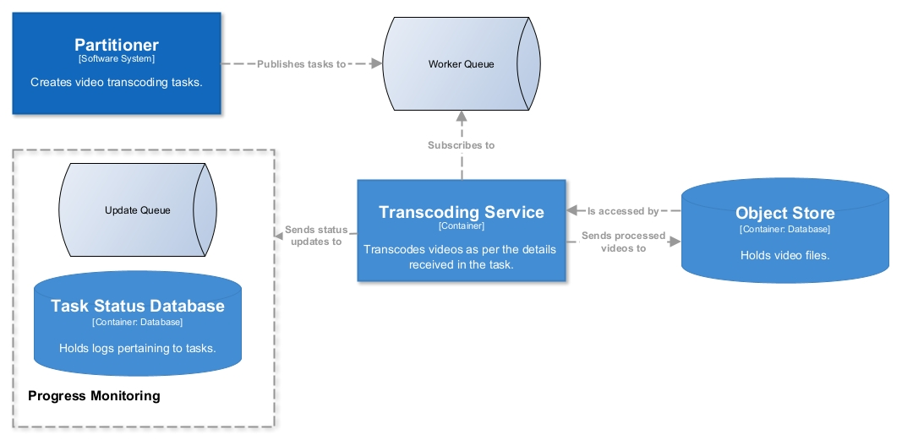
How is a Video Prepared For Streaming?

Slide 7
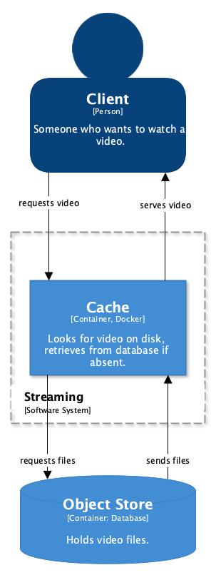
How is a Video Streamed?

Slide 8
Client Interaction
Gadi Polster, Eitan Remer, Chaim Schwartz

Slide 9



Workflow Management and Adaptive Streaming Group: Who We Are
I worked at the Metropolitan Commercial Bank this past summer. I enjoy reading, woodworking, and biking. Open to work offers.
Chaim Schwartz
Eitan Remer
Gadi Polster
Los Angeles, CA. I am starting work at Principal Financial in June. Fun fact about me is that I believe that peanut m&m’s are trail mix.
Cleveland, OH. Starting work at Healthfirst in September. My hobbies include running, bouldering, and baking.

Slide 10
What do we do?
Receive a video via a React webpage
Segment the video into smaller pieces
Then wrap segments into bigger partitions
Send partitions to be transcoded

Slide 11
Handling Heavy Upload Traffic
Multiple instances listening to client side server
Docker Swarm, HAProxy
Big files can cause a big wait
Distribute work
Notes:
In order to allow for a heavy upload traffic we implemented Docker Swarm and Haproxy.
Deploying our upload listening server in swarm enabled us to create multiple instances therefore if one server is busy uploading another user can still proceed as if nothing was happening.
However due to the various endpoints our code needs to hit for mongo etc.
we rely on Haproxy to route all the instances to the correct endpoint and ensure each instance does its own work instead of doing the same work on each instance.

Slide 12
Difficulty of Adaptive Bitrate Functionality
Adaptive Bitrate Functionality
FFMPEG
Differences in number/size of segments and partitions
Multithreaded Task creation
Instances blocks until raw files are uploaded to object store
Notes:
Adaptive Bitrate Functionality means the video player can switch to any resolution but on desired quality or on available bandwidth.
Simple in theory but creates many difficulties in practice. As mentioned the video file itself can be very large so it must be broken up.
We do this by using code provided by the Transcoding team that serves as a wrapper to FFMPEG, an open source program that can split up videos into pieces.
This wrapper could create hundreds of segments depending on the lengths of the video, therefore we compress the segments into bigger partitions (10-50 segments) and store in the object store.
However the segments are not all the same size, a higher resolution will require much more space for a 6 second video piece than a lower resolution.
Therefore we created a calculator to provide the math required to keep each partition roughly the same size and split each resolution into a separate thread so our end of the upload process doesnt take much longer than it would for one resolution.
Much more efficient to have a group of segments put into a bigger partition to avoid needing to upload download and process for every small peice

Slide 13
Distributing our Task using a messaging bus
Pub/Sub - we are the Pub!
Asynchronous messaging
Uses UUID to ensure no conflicts in IDs uniqueness
Reliability
No need to reinvent the wheel!
Notes:
After each partition is ready it is sent via rabbitmq to Transcoding subsystem.
Rabbitmq is a pub/sub queue which allows us to publish our tasks giving the transcoding team the ability to subscribe and this decouples the creating and processing of tasks.
Next they can begin transcoding, meaning convert the video into the chosen resolutions. Tasks include a task ID, Status, and all relevant information on location and desired work.
How can we have a unique identifier if there are multiple instances running as previously mentioned? We use a UUID Universally Unique Identifier class provided by Java that create globally unique IDs.
RabbitMQ ensures that the message will be received even if one of our servers go down. As we have learnt when there already exists a program that fits the bill, theres no need to create a new one from scratch.

Slide 14
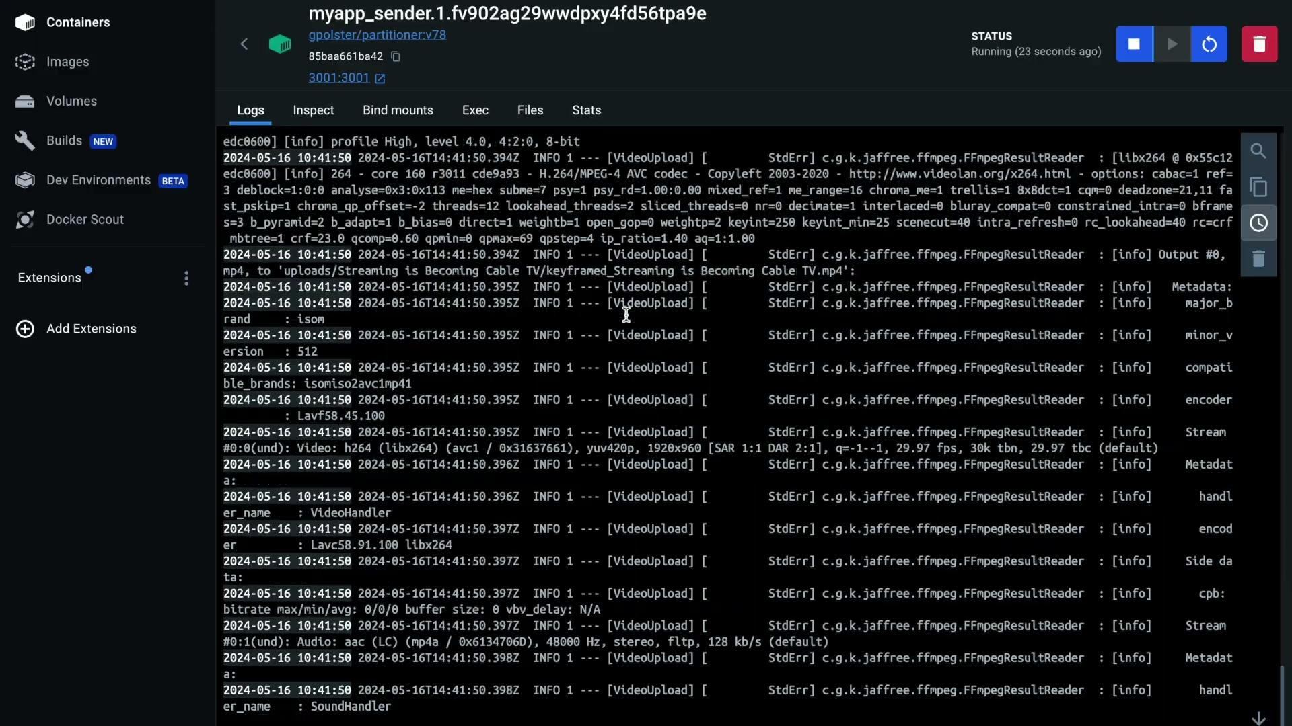
Demo - partitioning, uploading, and sending

Slide 15
Task Failure
What happens if a Task to transcode a part of the video fails?
Status is updated and sent via a different RabbitMQ message exchange
We receive the message with a FAILED tag
Request needed metadata from MongoDB instance
Create a retry task with an incremented requeue number
Also allowing the user to fail the upload and try again

Slide 16
Client Update Service
SSE
Server sent events are integral to allow our clients to understand what is happening.
We have our react application subscribed to our Server-Sent Events located in our spring app.
Our Spring app is listening for updates coming in and streams it out to the client.
This is key to allow a user to gauge how long an upload may take.
Notes:
Centralized Logging:
MongoDB provides a centralized storage solution for logs making it easier to analyze data
Docker Swarm:
Fault tolerance features ensure that logging data is reliably stored even if individual containers or nodes fail
Scalability:
Spring’s support for asynchronous programming models and integration with MongoDB’s distributed architecture enables the REST API to scale horizontally by adding more nodes to the system, handling increased loads effectively.

Slide 17
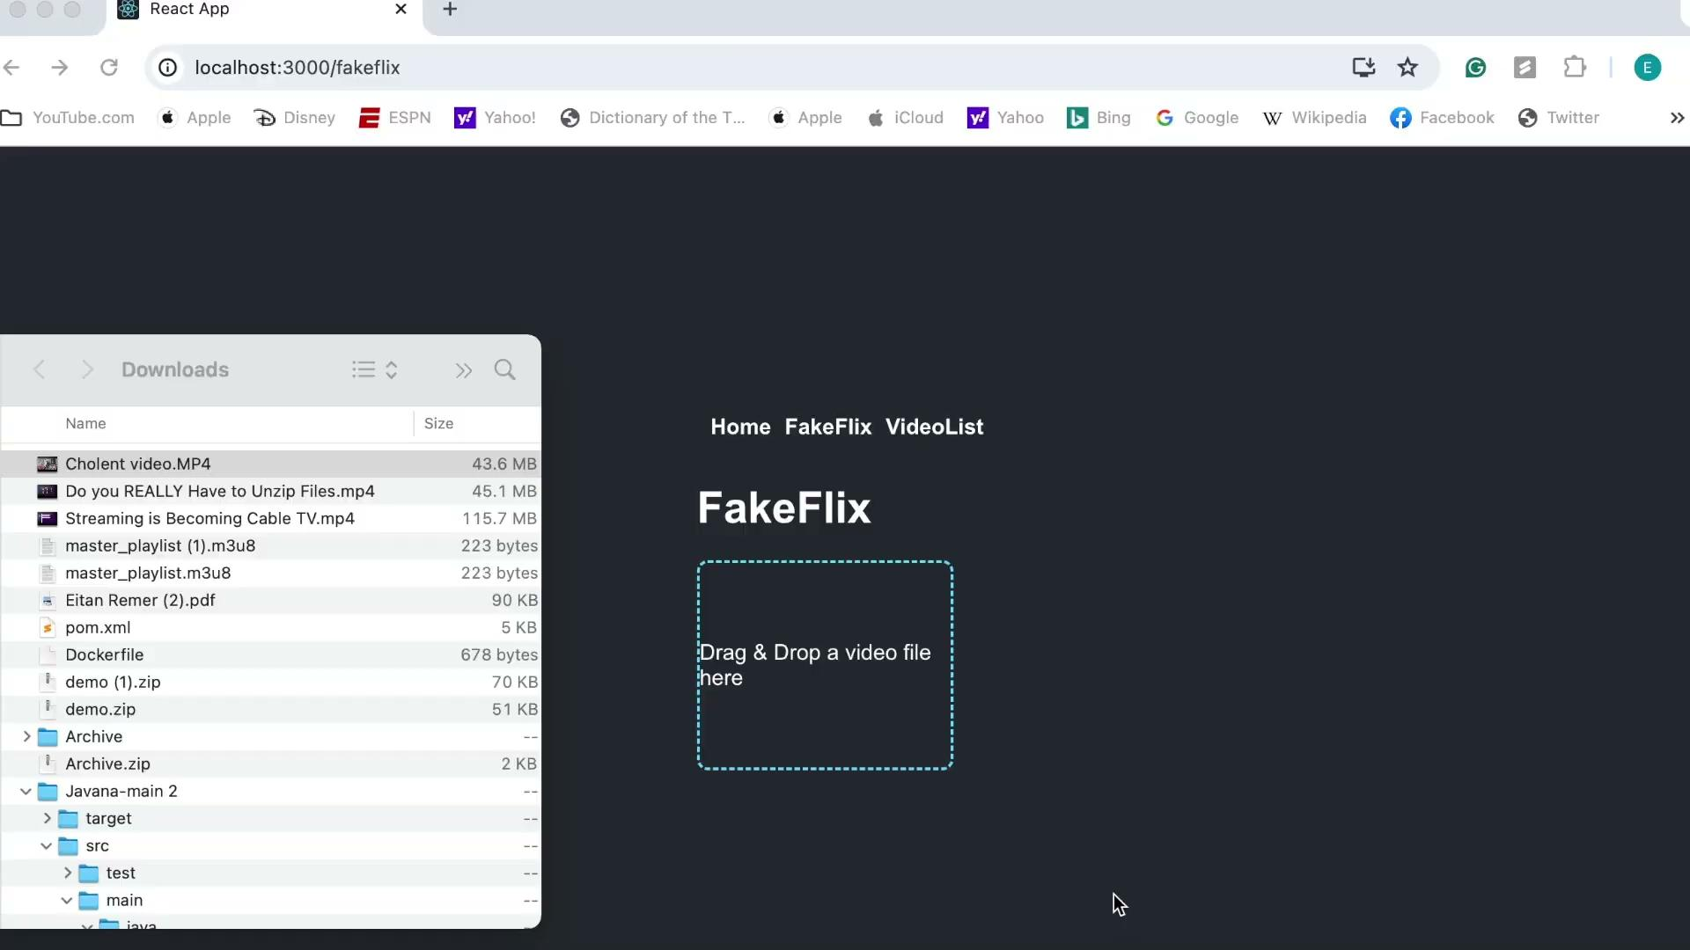
Demo status updates

Slide 18



Video Transcoding Subsystem Group: Who We Are
I worked at the Federal Reserve this past summer and plan on starting grad school in the fall. I enjoy bike-riding, running, and hiking. Open to work offers.
Lawrence Snow
Yonatan Reiter
Ephraim Crystal
Interned In Israeli startup for the last two summers. Starting a full time job in Operative’s office in NY in the upcoming summer. Captain of the YU soccer team.
I worked at Prudential for the past two summers and will be returning there this summer. I like improvising on the piano 🎹

Slide 19
Video Transcoding Subsystem
Efficient Task Processing
A Scalable and Efficient Distributed System to Prepare Videos for Adaptive Bitrate Streaming • From 📹 to 📺
Lawrence Snow • Yonatan Reiter • Ephraim Crystal
Notes:
We’re trying to make a etc… (dynamically change resolution and bitrate (amount of data transferred in the video) of video based on factors - internet etc.)
we process requests that we receive regarding the video the client uploaded.

Slide 20
Goal: Transcode Video Segments Efficiently
Many resource-intensive tasks.
Meet SLA by:
processing tasks in parallel and
running across multiple machines.
Want to utilize all resources efficiently
… yet not pay for unused processing power.
Notes:
Imagine running tons of tasks on one machine, do simple math to show that more machines = better
95% of video uploads will complete within [X] minutes for files up to [Y] GB in size, assuming adequate client-side upload bandwidth. To expedite running them
For maximal throughput

Slide 21
Preconditions: Our Starting Point
Tasks have been published to the worker queue.
Raw video files are in the object store. 📁
Notes:
First bullet point - aforementioned service.

Slide 22
The Very Basics: Compute Function Per Task
Dequeue task from the queue.
Transcode the specified files.
Retrieve relevant video file from the object store.
Unzip to access individual segments.
Transcode segments.
Zip segments into file and upload to object store.

Slide 23
Basics of Auto-Scaling
Having a centralized queue allows us to scale.
Docker Swarm makes it easy to scale a system by services and by machines.
When should we scale up or down? ❓
Notes:
PubSub. Makes scaling easy. When downscaling, just unsubscribe, finish work, gracefully shut down
As was mentioned, we need to be able to run tasks in parallel and across machines to meet SLAs

Slide 24
When to Scale…
By services?
Depending on the number of messages on the queue and how they compare to pre-configured values.
By machines?
Whenever scaling by services, make sure the ratio of services to machines is reasonable.
👷👷👷👷 🏗️🏗️

Slide 25
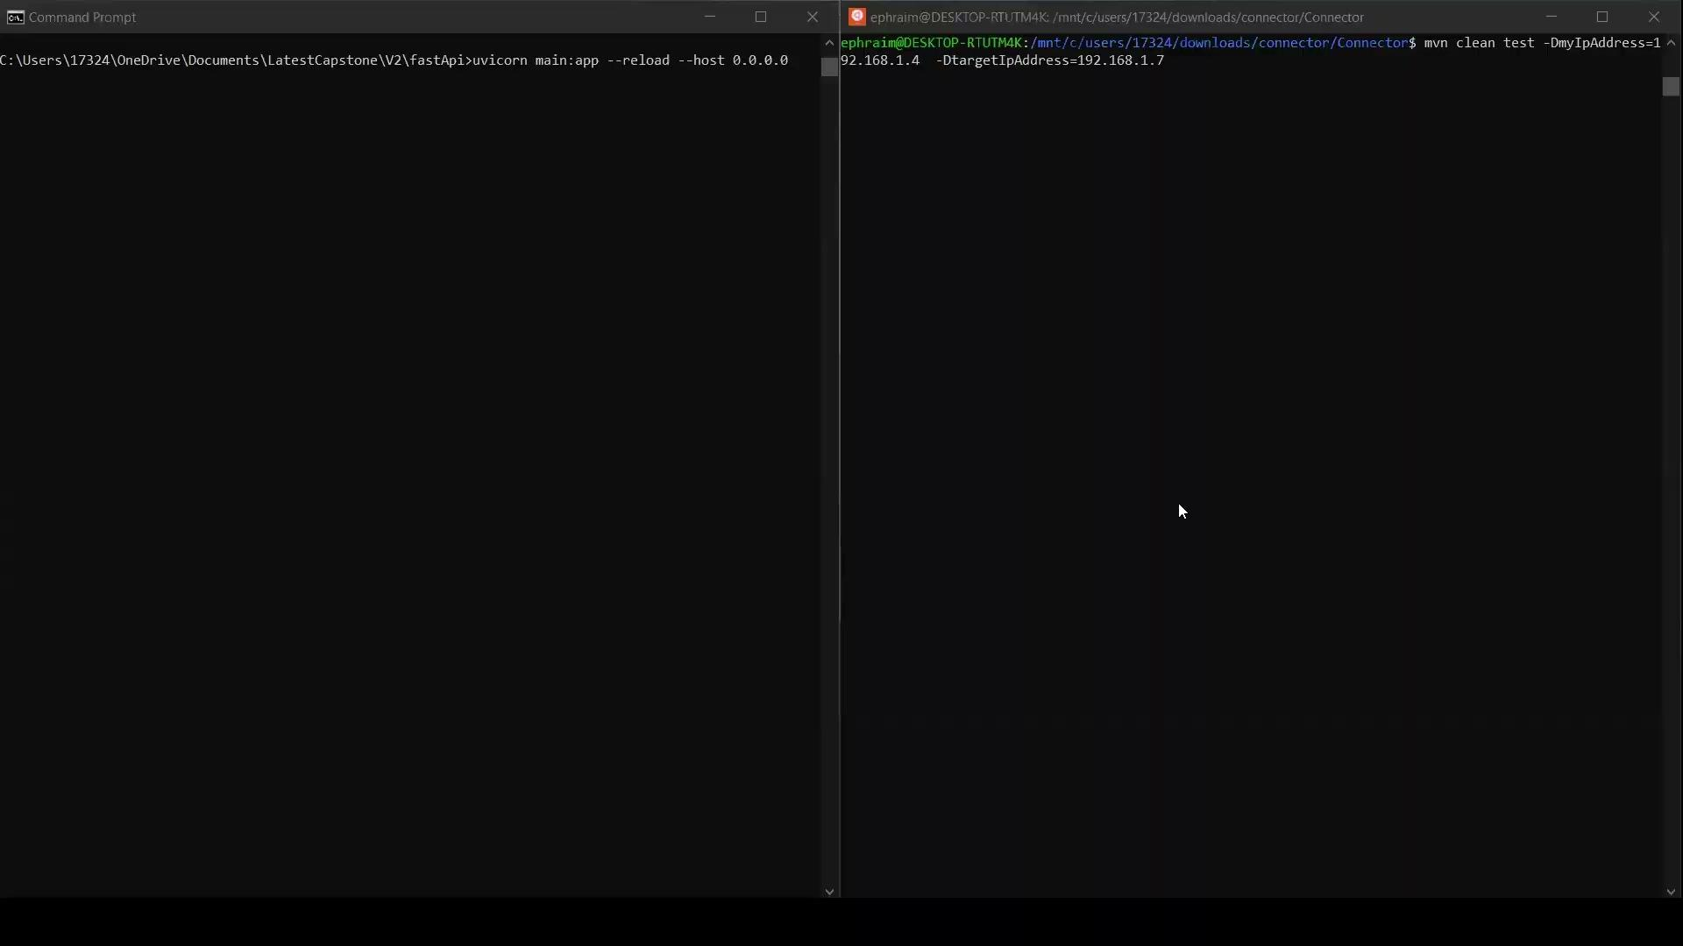
Notes:
Explain maven join Explain how/when you receive commands from the manager Explain that you scaled.

Slide 26
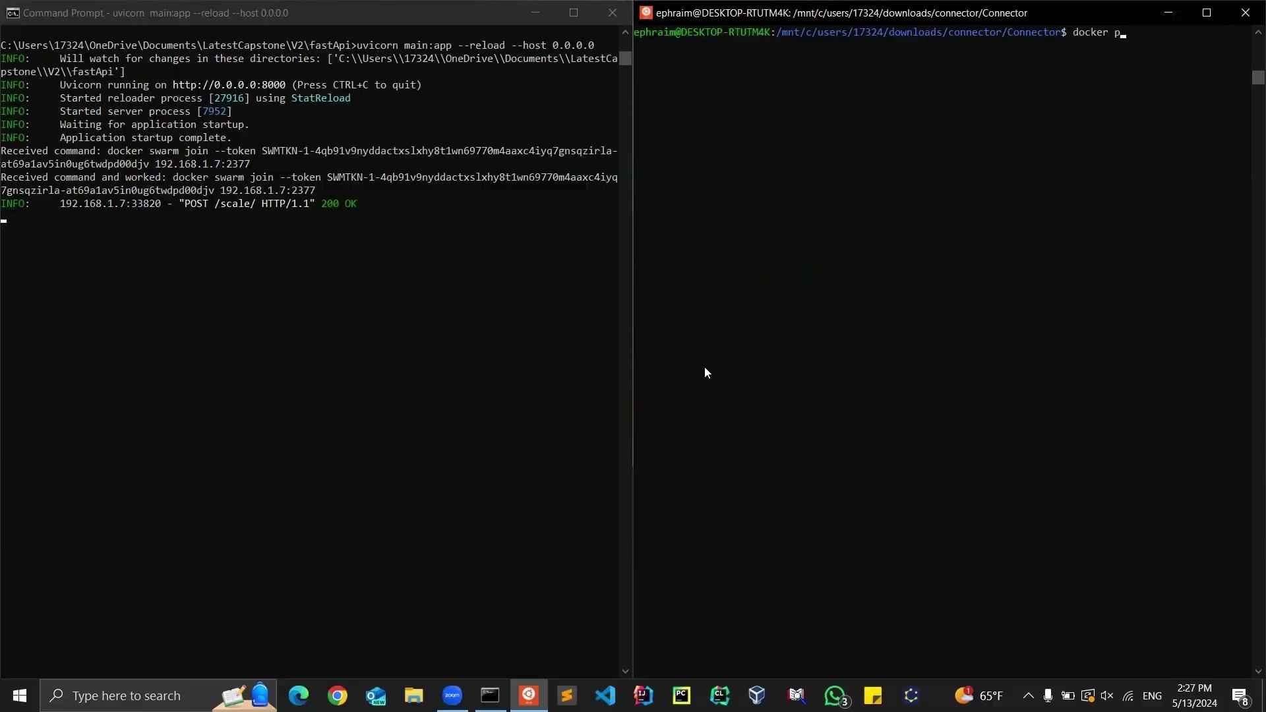
Notes:
Fast api is always running - define fast api
If not needed - leave command is sent
Everything is shut down. (work is saved)
Fastapi still running in case machine is ever needed again.

Slide 27
What About a Failure?
If a service is in the middle of a task and the service fails, how do we ensure that the task gets completed?
RabbitMQ helps us solve this: 🐰
Only acknowledge having received a task once the task processing is entirely complete. ✔️
This way, if a task is force-stopped while in progress, a new container will receive that same task and complete it. 🤯

Slide 28

Notes:
When a container fails, this is what happens. The forcing it off is like it’s failing

Slide 29
Failure Handling 😱
Many moving parts → many things that can go wrong! 💔
Three cases of failure:
Container fails → Docker Swarm detects it and spins up new container 😌
No need to worry about lost work due to RabbitMQ trick mentioned earlier 🐇
Push/pull error (transient/recoverable) → Retry a few times with exponential backoff ♻️
Escalate if still not working 🆘
Transcode error (non-recoverable) → escalate right away! 🆘
Orchestrator decides how to act based on the failure(s).
Notes:
Professor said it’s important to use the “recoverable” keyword
Mention transcoding specifically - if one segment fails maybe that doesn’t make such a difference, but if a bunch fail, the video might be entirely corrupted and not worth continuing the processing, and thus the orchestrator would stop the job and send a message to the client saying that it’s corrupted

Slide 30
Key Technologies 🔑
Code is written in Java ☕ (with key transcoding features using FFmpeg libraries and key database features using S3 libraries),
packaged with Maven, 📦
containerized with Docker, 🦆
and orchestrated with Docker Swarm. 🐝🐝🐝
Task status updates are saved to a MongoDB instance and published on RabbitMQ for real-time updates to the client. 📜
Receive tasks by subscribing to a RabbitMQ worker queue. 🐇
Notes:
Packaged - a java file has external dependencies it relies upon. We build one application with all of these dependencies built in.
containerization= further abstracting an application in a standard and self-contained manner such that it will run the same way everywhere
Orchestrated - deploys and manages docker containers Containerized with docker - multiple services, all orchestrated with docker swarm
Mention pub/sub pattern

Slide 31
Streaming
The video player first requests the manifest file
A manifest file stores the information on the length of each segment and its location
The cache servers parses those requests and determines the partition where that segment is located and sends a requests through RabbitMQ.
Every instance of the cache server is paired with a filedownloader instance that pulls from the object store and places it in shared storage
Notes:
Im gonna start by explaining how streaming works
The simplest way to implement this would be to connect the video player directly to s3 but that would but that would cause many issues:
The network overhead on requesting each small segments of 6 seconds from s3 would quickly overwhelm the network.
The extra bandwidth needed to re retrieve the same segment when the video is played by another client would be.
In order to have access to the playable files we first start by retrieving the manifest file from the object store
The manifest file contains all necessary information describing segment length and location allowing us to know what we want next
The cache acts as a translator, taking the segment and determining which partition it is stored in. Giving us the ability to retrieve that file from the object store
This is achieved by a FileDownloader instance which is paired with each cache server, which is where we actually pull down the file from the object store and place it into shared storage

Slide 32
Cache server + Replication
Every instance of filedownloader is listening to the same queue so each cache server has the same files on it no matter which instance received the initial request.
The server when it receives a request it can lookahead for the next file the video player is likely to request and it can preload it from S3 as well
Grouping segments into partitions in S3 reduces the amount of network calls that have to be made
When a request is made for a video that is already cached it does not have to go back to s3

Slide 33
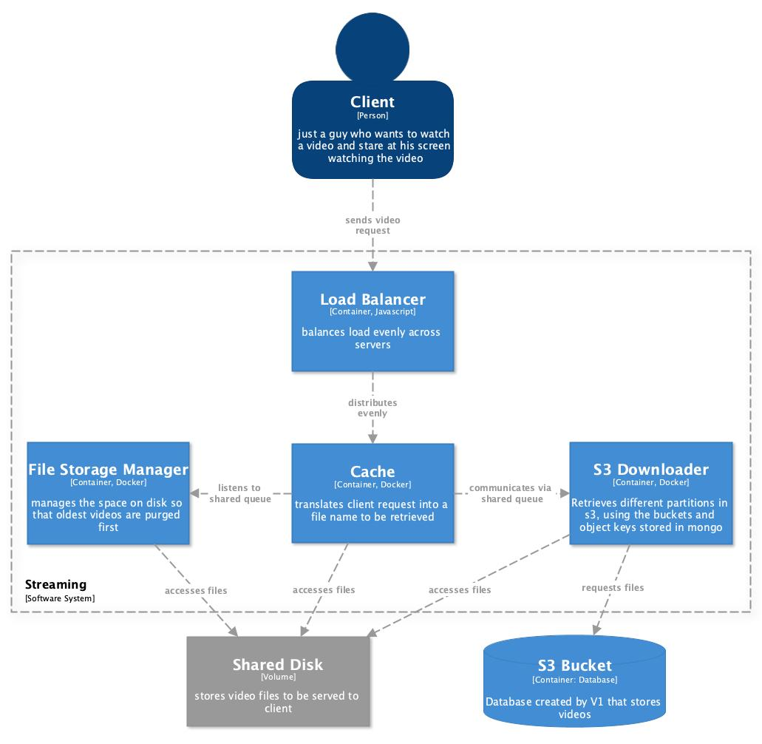
How a video is Streamed?

Slide 34
Fault Tolerance
HAproxy uses a round robin algorithm to evenly distribute requests across the system ensure no one server gets overloaded
If a server goes down Haproxy will remove it from the round robin list
The user will not experience any buffering because the next server has replicated the file requests
We have multiple instances of these caching servers at the ready to pick up slack from another server reducing latency for our clients

Slide 35
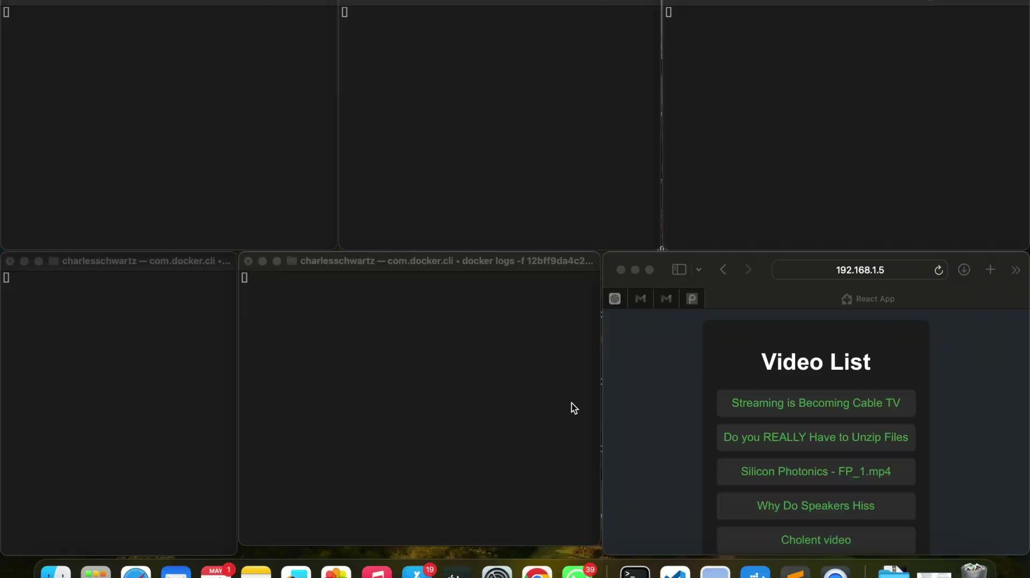
Demo streaming and requesting

Slide 36
Plan for the Next Iteration ⏭️
Ideally we would like to create a security layer for the app, restricting users to their own accounts through user credentials.
Handle duplicate files so the system cannot be overrun with bad data.

Slide 37
Key Technologies 🔑
Code is written in Java ☕ (utilizing Spring Boot for the API with key transcoding features using FFmpeg libraries),
packaged with Maven, 📦
and orchestrated with Docker Swarm. 🐝🐝🐝
Used HAProxy for load balancing. 🖥️🖥️🖥️
Using React for frontend. 🧔‍♂️
Updates are logged to a MongoDB instance. 📜
Tasks are sent via a RabbitMQ instance to orchestrate distribution. 🐇
Key technique: Balancing multiple instances across servers to delay lag time.

Slide 38
Distributed Object Storage
Azriel Bachrach, Yaakov Baker, Max Friedman

Slide 39



Video Upload and Storage Group: Who We Are
I interned at Amazon this past summer and will be starting a career at Affirm this summer.
Fun Fact: I am I lifeguard at the YU pool
https://www.linkedin.com/in/azriel-bachrach/
Azriel Bachrach
Yaakov Baker
Max Friedman
Stoughton, MA native who will be working at Raytheon starting July
Fun Fact: I’m highly ranked in many video games, I love reading, and outdoor sports and activities
https://www.linkedin.com/in/yaakovbaker01/
I’m From Phoenix, AZ. Open to work offers.
Fun Fact: I’ve played the guitar for 9 years, love soccer and reading. https://www.linkedin.com/in/max-friedman8/
Notes:
Our whole part should be 12 minutes, video should be max 5 (prob less). Also focus on using less words

Slide 40

Goals: The Big Picture
Any streaming service needs somewhere to store its videos
Many streaming services store their videos in a cloud-based object store such as Amazon S3
We want to make a similar system
Notes:
max

Slide 41


Functional Requirements
Receive objects from clients and store them
Return the objects to clients upon request
We offer the same API as S3 so users can interface with our system using a standard S3 client.
Notes:
yaakov

Slide 42


Non-Functional Requirements
Scale to provide unlimited storage space
Scale to accommodate unlimited clients
Availability in the face of failures
No data loss
Notes:
yaakov

Slide 43

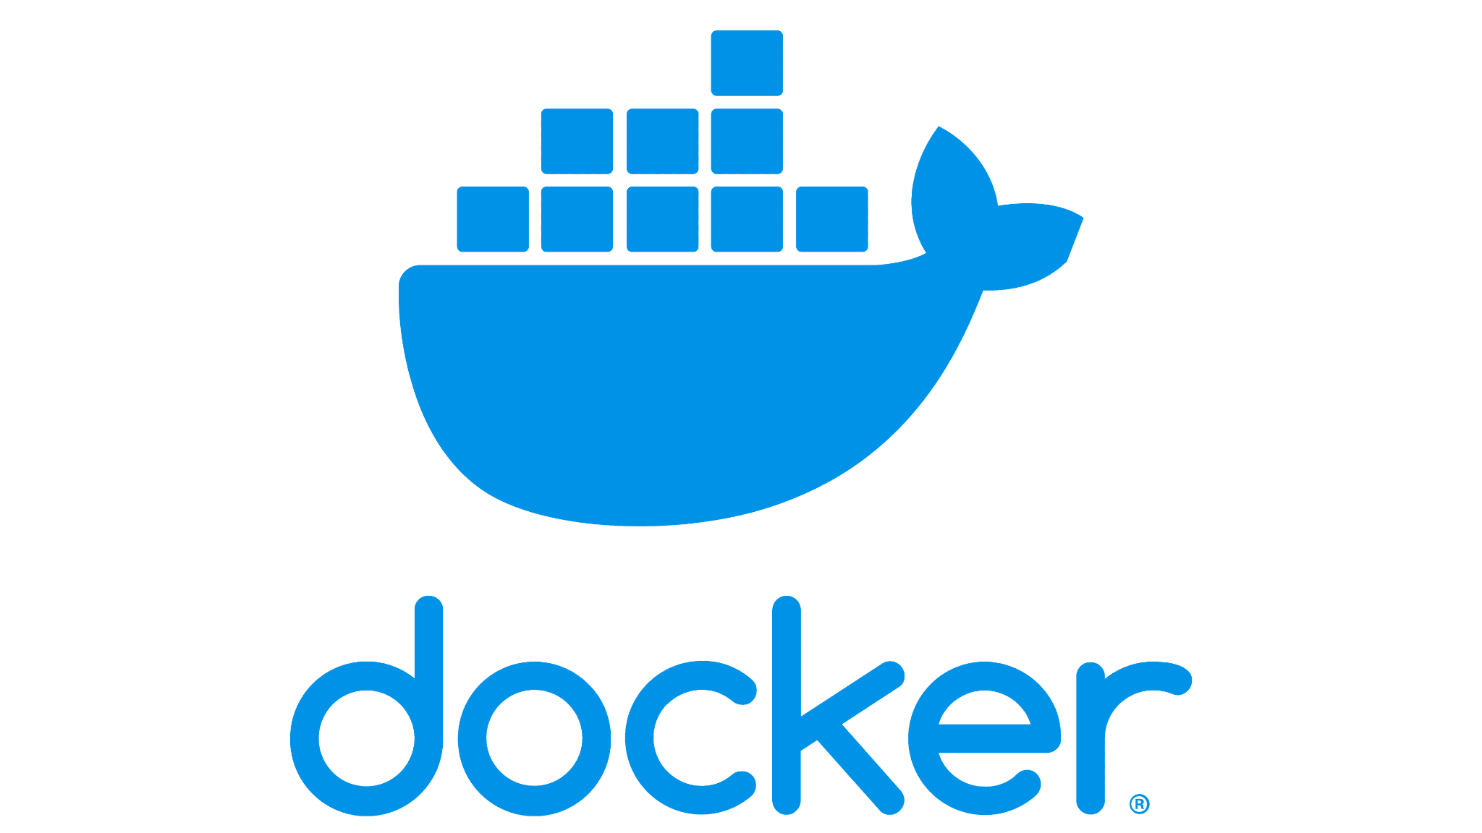



Key Technologies 🔑
Code is written in Java ☕ (utilizing Spring Boot for the API),
packaged with Maven, 📦
containerized with Docker.
Used HAProxy for load balancing.
Used Apache Zookeeper to manage the cluster of storage nodes.
Used Postgres as a database.
Key technique: Used a replication strategy to ensure nodes are fault tolerant and distributed
Notes:
max

Slide 44
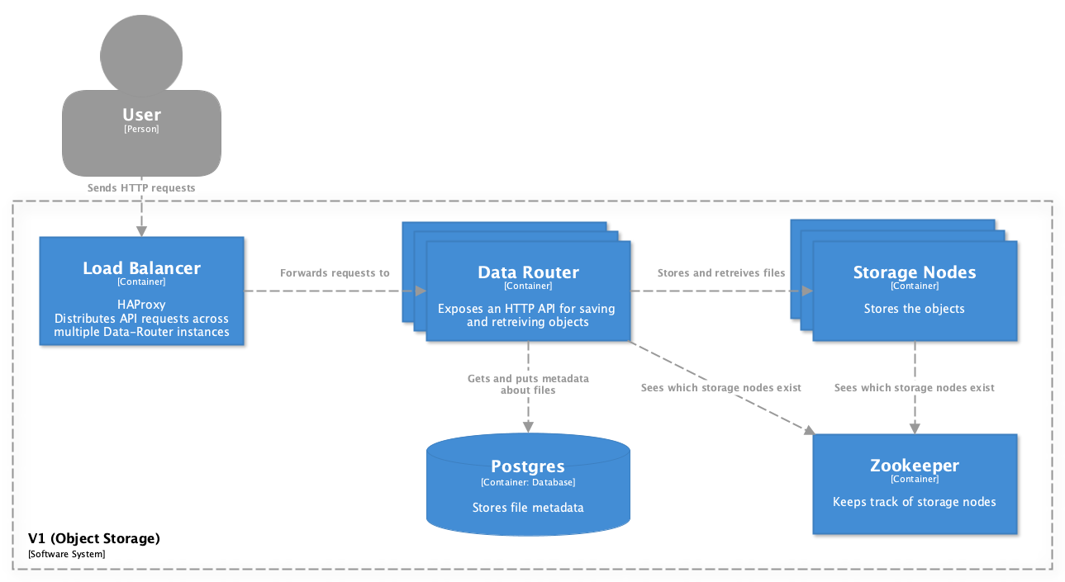
System Components
Notes:
azriel

Slide 45
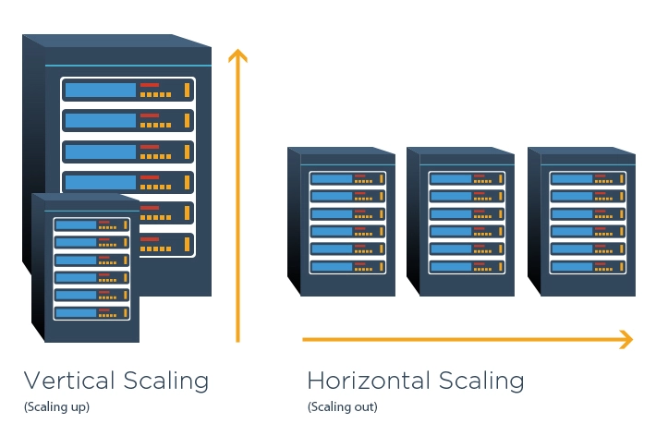
The Need for Scalability (Horizontal Scaling)
Scalability is needed to meet our non-functional requirements:
More storage space
More bandwidth (for client requests)
We provide scalability by:
Storing data across multiple storage nodes
Having multiple API instances that handle user requests
Notes:
max

Slide 46

The Need for Fault Tolerance
The reality is that computers break :(
Fault tolerance is needed to:
Not lose data
To continue handling user requests
We provide fault tolerance by:
Keeping multiple replicas of the same data across multiple storage nodes
Having multiple API servers that can handle requests
Notes:
max

Slide 47
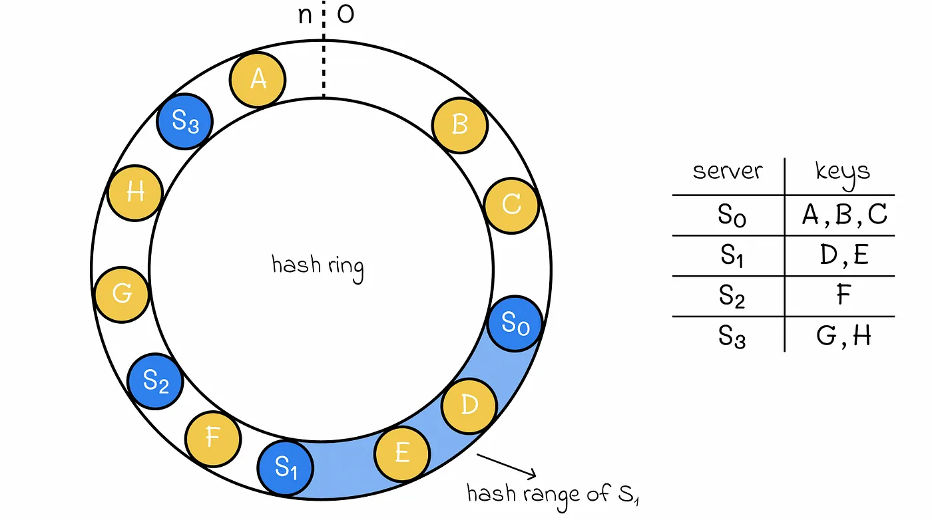
Consistent hashing
We use consistent hashing to determine the placement of files
Every storage node is hashed to a position in a ring
The files are hashed onto the ring and placed in the next server
Notes:
azriel

Slide 48

Replication
Data is replicated to the next 2 nodes in the ring
Total of 3 replicas
When a node fails, a replica gets copied to the next node in the ring to always maintain 3 replicas
Notes:
azriel

Slide 49

Apache Zookeeper’s Role
We use Zookeeper to manage our nodes
Zookeeper keeps track of live nodes in a list
When a node is created, zookeeper adds it
When a node is unresponsive, zookeeper removes it
Zookeeper ensures us invaluable coordination and bookkeeping of our system!
Other nodes can watch the list to learn about other nodes in the system
Notes:
max

Slide 50
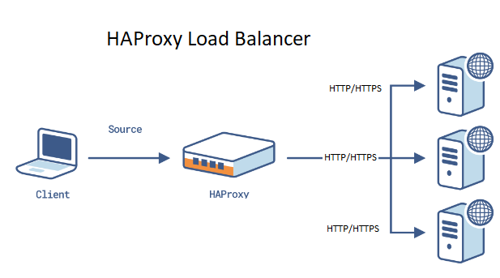
HaProxy and Load Balancing
Load Balancing to distribute client requests across multiple servers
prevents bottlenecks and controls load distribution
We utilize the Round Robin algorithm
Each server is monitored, making sure that requests only go to healthy servers
Uses HTTP (Hypertext Transfer Protocol) to send requests
Notes:
azriel

Slide 51

Benefits of Docker
Consistent Environment
No “It works on my machine” problem
Portability
Applications can be run on any machine that has Docker
Isolation
Applications are run in their own environment preventing conflicts
If one node fails the whole system isn’t taken down
Scalability
If our system needs to handle more traffic then more containers can be made
Notes:
yaakov

Slide 52
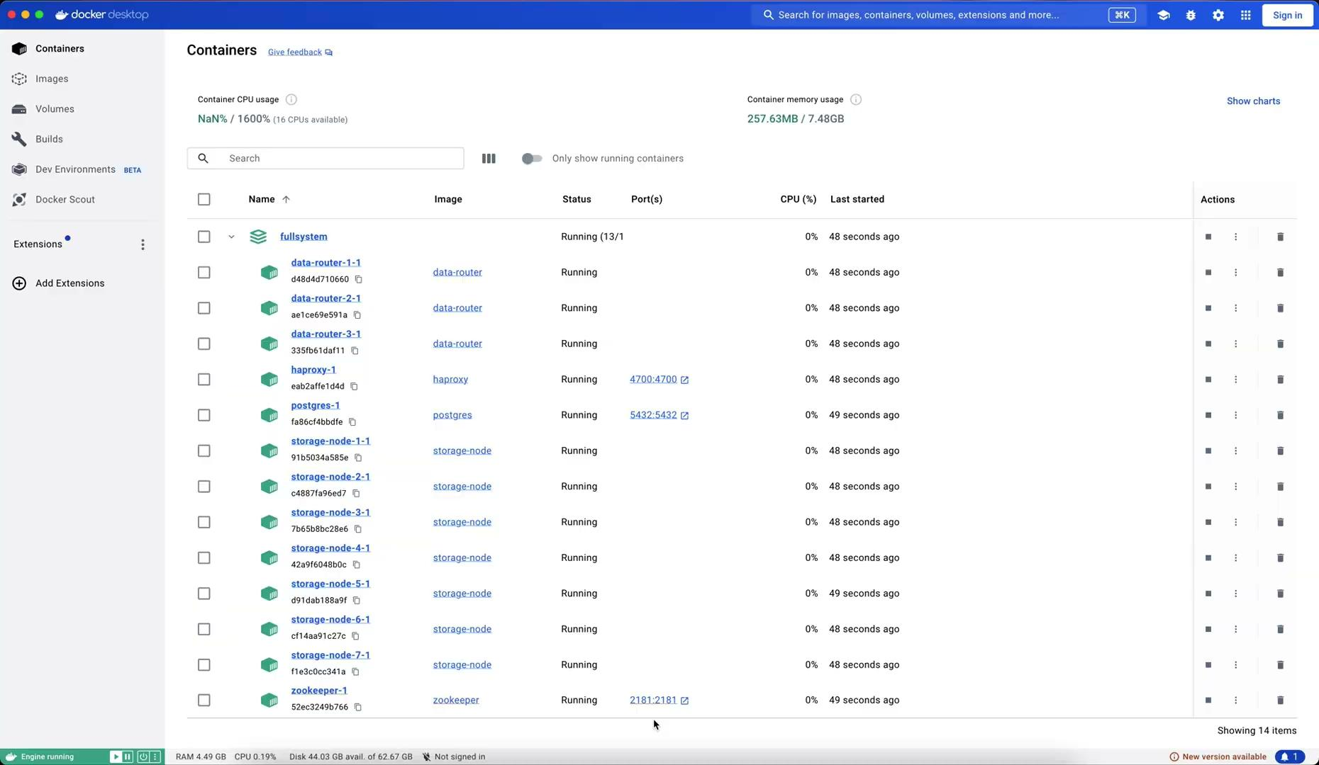
Demo

Slide 53
Any Questions?
🎓🎓🎓🎓🎓🎓🎓🎓🎓🎓🎓🎓🎓🎓🎓🎓🎓🎓🎓🎓🎓🎓🎓🎓🎓🎓🎓🎓🎓🎓🎓🎓🎓🎓🎓🎓🎓🎓🎓🎓🎓🎓🎓🎓🎓🎓🎓🎓🎓🎓🎓🎓🎓🎓🎓🎓🎓🎓🎓🎓🎓🎓🎓🎓🎓🎓🎓🎓🎓🎓🎓🎓🎓🎓🎓🎓🎓🎓🎓🎓🎓🎓🎓🎓🎓🎓🎓🎓🎓🎓🎓🎓🎓🎓🎓🎓🎓🎓🎓🎓🎓🎓🎓🎓🎓🎓🎓🎓🎓🎓🎓🎓🎓🎓🎓🎓🎓🎓🎓🎓🎓🎓🎓🎓🎓🎓🎓🎓🎓🎓🎓🎓🎓🎓🎓🎓🎓🎓🎓🎓🎓🎓🎓🎓🎓🎓🎓🎓🎓🎓🎓🎓🎓🎓🎓🎓🎓🎓🎓🎓🎓🎓🎓🎓🎓🎓🎓🎓🎓🎓🎓🎓🎓🎓🎓🎓🎓🎓🎓🎓🎓🎓🎓🎓🎓🎓🎓🎓🎓🎓🎓🎓🎓🎓🎓🎓🎓🎓🎓🎓🎓🎓🎓🎓🎓🎓🎓🎓🎓🎓

